Slide 1

Project on automatic birthday mail sending using python

Slide 2
IMPORT LIBRARIES
pandas
datetime
smtplib
time
requests
win10toast

Slide 3
Technologies used
jupyter notebook
py charm
vs code

Slide 4
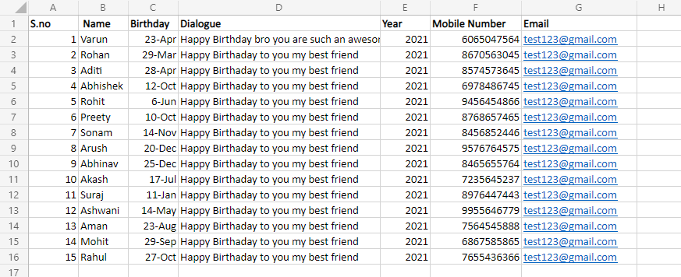
create an Excel sheet for containing records like this: Name, Email, Contact, Birthday, and Year.

Slide 5
DESCRIPTION
Create an Excel file that contains the name, email, mobile number, message, year, Time.
Using pandas fetch birthday year and date.
Create a send_email function that can be used to send an email. it takes email, message, and subject as input.
If the birthday year is equal to the current year, then don’t send the email because it is already been sent.
If today is equal to a birthday day, then check for the current time is equal to the wish time, then send the email using the send_email function and increase the year column by one.
Using windows scheduler makes the program run at every day 12:01 am.

